Slide 3

Adam Driscoll
- Owner\Lead Dev Ironman Software LLC
- PowerShell MVP
- Author, Blogger, YouTuber
- Really jet lagged

Slide 4






PowerShell Universal
A platform for building web-based tools with PowerShell
APIs
Automation
Apps
Security
Development
PowerShell Focused

Slide 5
Service Catalog
End User Portal
Request Approval
Notifications
Persistence

Slide 6
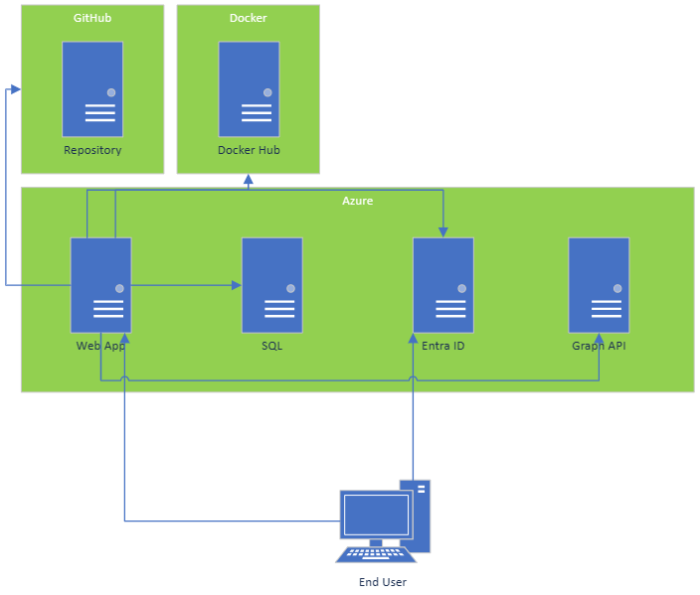
Overview

Slide 7
Demos

Slide 8
Demo: Setup
Azure Web App \ Docker Container
Git
Entra ID Authentication\Authorization
GraphAPI
Teams
Azure SQL

Slide 9
Demo: Create User
New Entra ID User
Self-Service Form
Notification
Teams Channel

Slide 10
Demo: Provision Machine
New Azure Virtual Machine
Self-Service Form
Request Approval From Manager
Notification
Teams Channel

Slide 11
Demo: Custom Service Portal
Role-Based Access
Search Services
Integrated Forms
Request History

Slide 12
Q&A
15 minutes
Use PSDAYCH20 to get 20% off any Ironman Software product on our website

